Slide 1

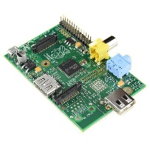





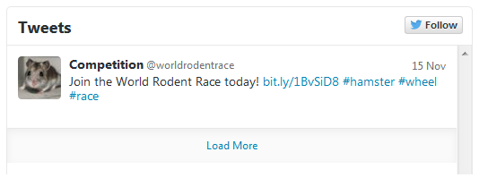
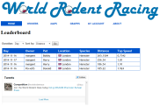
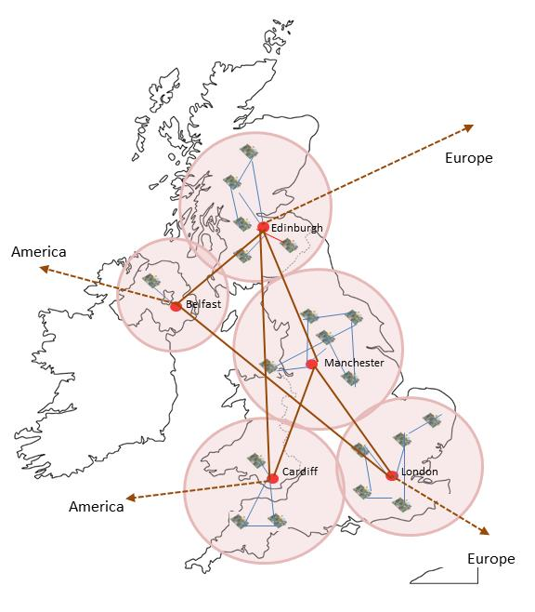
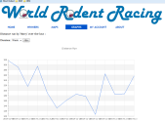

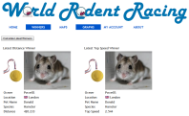


Asleep at the Wheel
To allow schools and families to collaborate across the globe by recording the distance and speed their pet hamsters travel on their wheels…
Here come’s the tech…
We’ve got a MySQL local database holding personal information about your family or school. This stays safe on your Pi.
Each Pi has a Gaian database holding the distance and speed data. This is distributed between players. If one contestant drops out, their data is preserved and still available from the other participants’ databases.
Boldly going where no hamster has gone before…
We see the benefits of this invention in…
The ability to ensure data resilience through the Gaian database…
The ability to work together across geographical boundaries through distributed data…
Taking it social and global…
Our Twitter feed @worldrodentrace tweets the furthest run and fastest daily. You can follow us or read the feed on the website.
Our Google Maps API allows us to show the distance each hamster has run and plot them on a map to show recent runs and the distribution of our competitors.
Where it begins…
Step 1: Register your hamster
Step 2: Set up your hamster wheel and contact switch
Step 3: Wait for darkness to fall…
Step 4: Race!
Step 5: Check where your hamster ranks
Step 6: See your hamster’s stats

